Slide 1
Microprocessor System Design
Omid Fatemi
Output Design
(omid@fatemi.net)

Slide 2
Class Work #7
Input / Output design

Slide 3
First Part – Closed-Book

Slide 4
Questions
What are the two methods to find out if data is available or not?
What is the command to get data from an input port?
What is the difference between a read memory cycle with an input cycle in 8088?
What are the address modes for Input / Output ports? And which port numbers do they cover?
How an output peripheral could interrupt the processor? i.e. when this interrupt should occur?
Notes:
Write two differences between memory mapped IO and peripheral addressing.
How could we use polling to find out if an input peripheral has data ready?

Slide 5
Open-Note

Slide 6
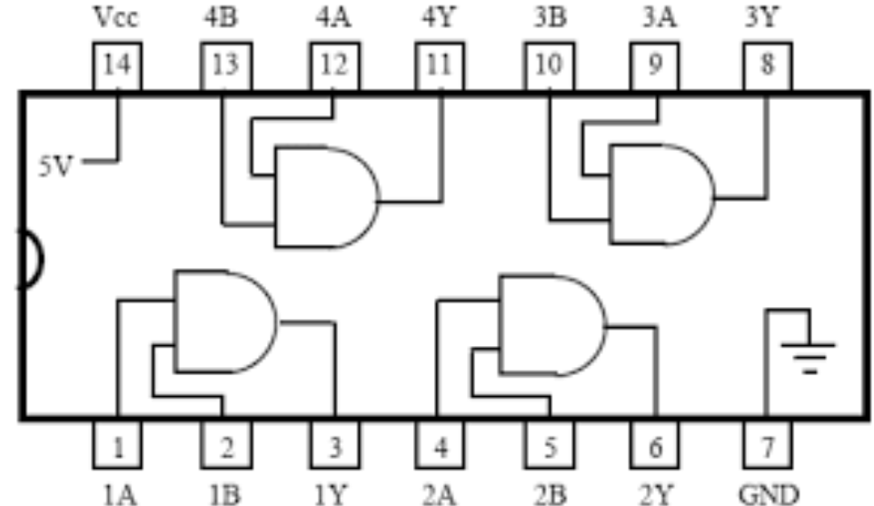
Problems
Design IC tester with 8088 and one 8 bit latch and one 4-bit buffer. IC under test is a 7408 (And).
Map latch to address 300H
Map buffer to address 301H
Write the program to apply all four sets of inputs to all four gates and if all of them are OK, then write 1 to memory location 50H and otherwise write 0 to that location.
Notes:
Using 4-bit latches and only address port 0300H, design a circuit for controlling 16 LEDs
Then write a program to put this pattern on LEDs: 0000010100111111
(you should only use out command to port 300H. Don’t use gates for any data bit. Hint: one data bit for selecting one latch).

